Slide 1
CenturyLink Data Lake Architecture
Environments and Usage

Slide 2
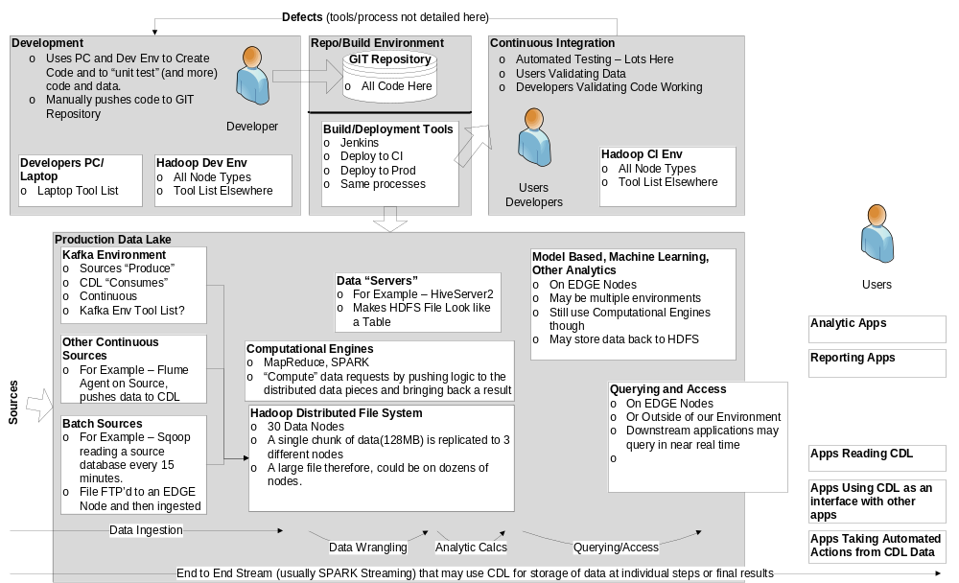
CDL Functional – One Page Diagram
Last Update: 10/27/2016

Slide 3

Appendices
Last Update: 6/4/2017

